Slide 1

DATABASE SYSTEMS (EIE36E): EXERCISE #2
Doc. Ing. Václav Vostrovský Ph.D.
Ing. Petr Hanzlík

Slide 2
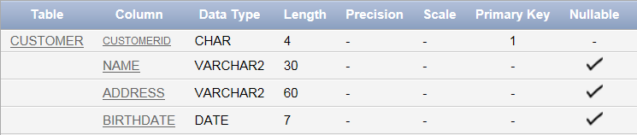

Task 1 - Revising the SQL DDL
Create a table storing information about customers with the following structure:
Note: Implicit length of DATE data type is 7 bytes, you do not need to set it up!

Slide 3
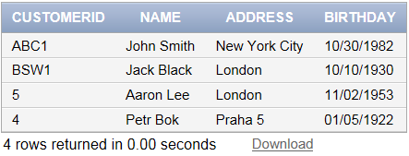
Task 1 - Revising the SQL DDL
Fill the table with following entities:
Formatted input data:
'ABC1', 'John Smith', 'New York City', '10.30.1982'
'BSW1', 'Jack Black', 'London', '10.10.1930'
'5', 'Aaron Lee', 'London', '02.11.1953'
'4', 'Petr Bok', 'Praha 5', '05.01.1982'

Slide 4
Task 1 – Solution
Run following SQL commands:
CREATE TABLE customer ( customerID CHAR(4) PRIMARY KEY, name VARCHAR(30), address VARCHAR(60), birthday DATE);
INSERT INTO customer VALUES ('ABC1', 'John Smith', 'New York City', '10.30.1982');
INSERT INTO customer VALUES ('BSW1', 'Jack Black', 'London', '10.10.1930');
INSERT INTO customer VALUES ('5', 'Aaron Lee', 'London', '02.11.1953');
INSERT INTO customer VALUES ('4', 'Petr Bok', 'Praha 5', '05.01.1982');
SELECT * FROM customer;

Slide 5
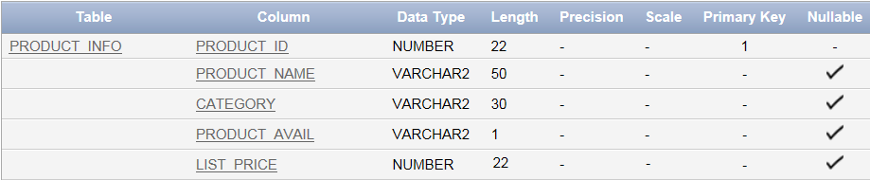
Task 2 - SQL DDL and DML
Create a table with the following structure:
Note: Implicit length of NUMBER data type is 22 bytes, you do not need to set it up! Define productID just as follows: ‘ProductID NUMBER, …’

Slide 6
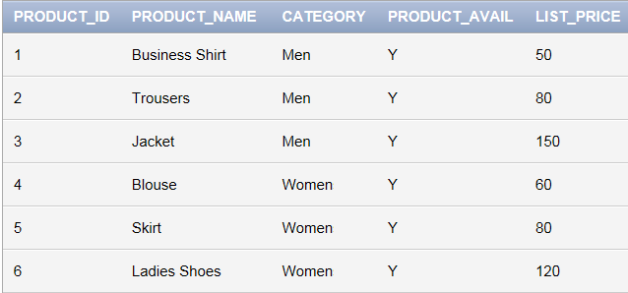
Task 2 - SQL DDL and DML
Fill in the tuples:

Slide 7
Task 2 - SQL DDL and DML
Add a new attribute called ’colour’ to the ‘product_info’ table
Update ‘Business Shirt’ to be of colour blue, all the other tuples should be black;
Display product name with price and colour only.
Select products from the “Men” category

Slide 8
Task 2 - SQL DDL and DML
List product_name and price only, order products from the most expansive to the cheapest
List all the distinct colours in the product portfolio
Select products from the “Men” category cheaper than 100$

Slide 9
Task 2 - SQL DDL and DML
What is the maximum price of a product?
What is a minimum price of a product? What is the average price?
Select complete description of the most expansive product.
Count how many products of each colour are available in the store

Slide 10
Task 2 - SQL DDL and DML
Delete all the products cheaper than 50$
Remove the entire product_info table, including all the data inside.

